Slide 1
Emergency remote teaching retrospective
Jennifer Brown, VPDUE
August 11, 2020

Slide 2
Undergraduate Education’s Core Goal
Working with partners to improve retention and graduation

Slide 3
Working with Partners
Deans & Associate Deans
Senate leadership
Department chairs
Faculty
ITS
Library
Student Affairs
Graduate division
Institutional Research
Procurement
Each provided critical and ongoing support to the emergency remote teaching efforts of Spring 2020.

Slide 4
Data sources
Faculty survey distributed via associate deans
University of California Undergraduate Experience Survey (provisional)
Engagement through UE and partner groups
Evaluating Impact

Slide 5
Faculty Experience

Slide 6
Campus Survey
90% Indicated College
Distributed via associate deans
228 responses, 89% teaching in spring
Faculty Responses
Notes:
Data below are from 203 responses indicated they did teach in spring

Slide 7
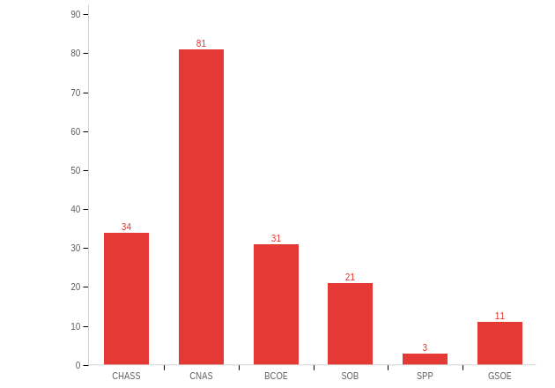
What college/school do you work in (majority of your time):

Slide 8
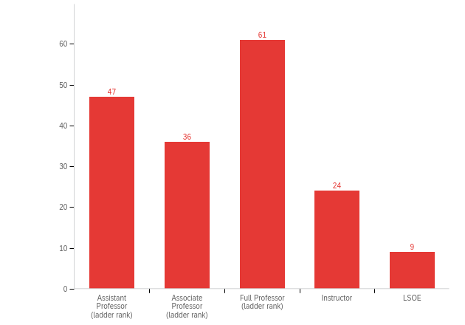
What is your present academic position?

Slide 9
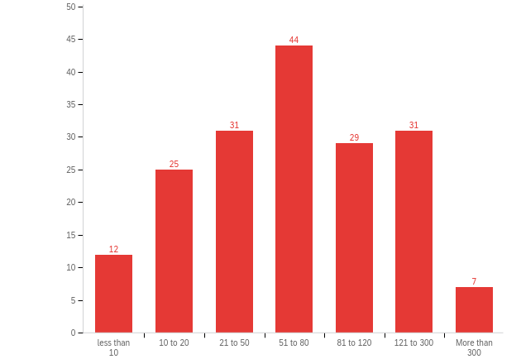
What was the enrollment for this course?

Slide 10
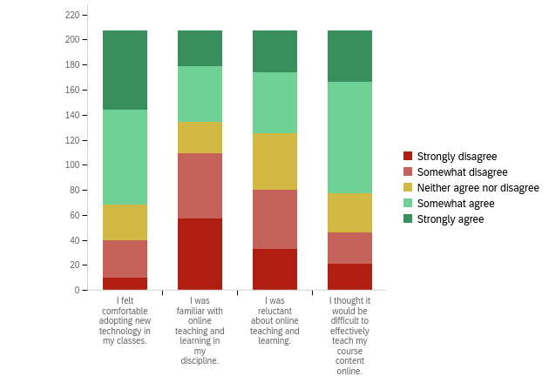
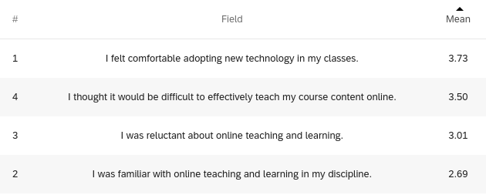
The following items pertain to your experience before the transition to remote instruction.

Slide 11
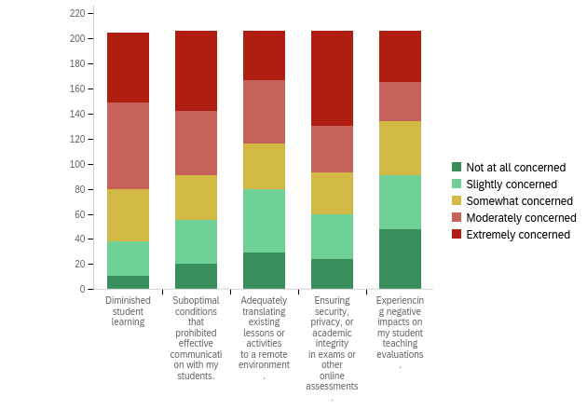
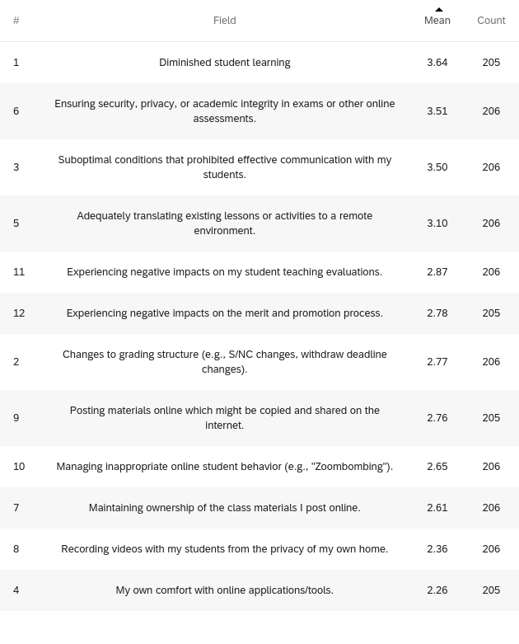
Please indicate your level of concern regarding the following aspects of the transition to remote instruction during spring 2020.

Slide 12
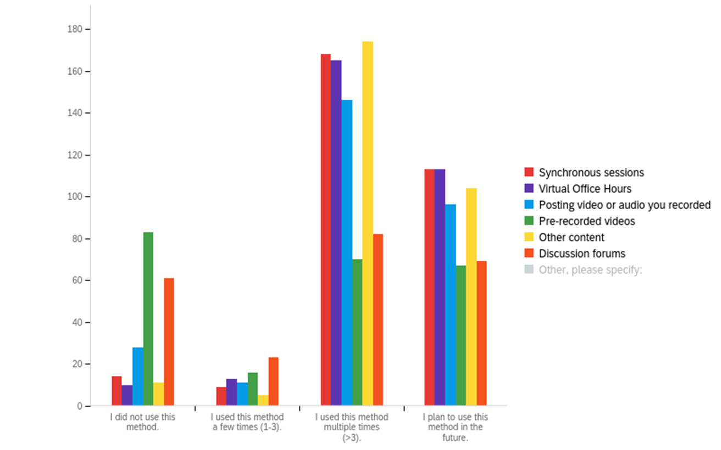
For spring 2020 courses that you taught remotely, please indicate which instructional methods you have used, how they worked, and what you will use in the future.

Slide 13
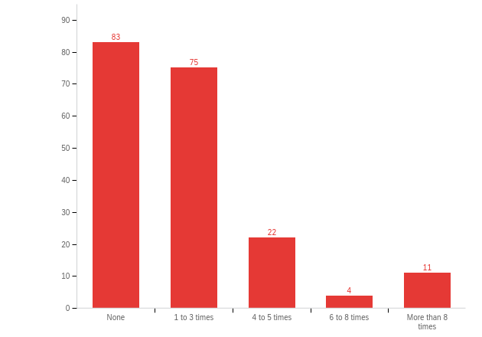
Number of times in a typical class you poll students to check for understanding (using Zoom poll, Poll Everywhere, or similar).

Slide 14
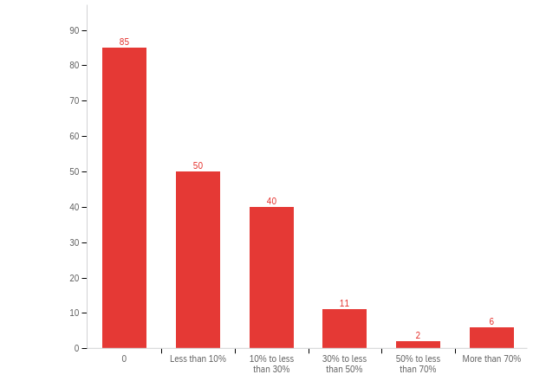
Fraction of class time students are in small group discussions or problem-solving in Zoom breakout rooms (or similar technology)

Slide 15
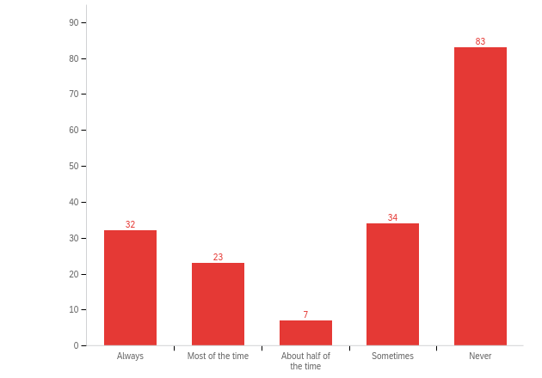
How often did TAs support online class sessions by monitoring and responding to student questions posted in chat box or other question-asking formats including breakout rooms?

Slide 16
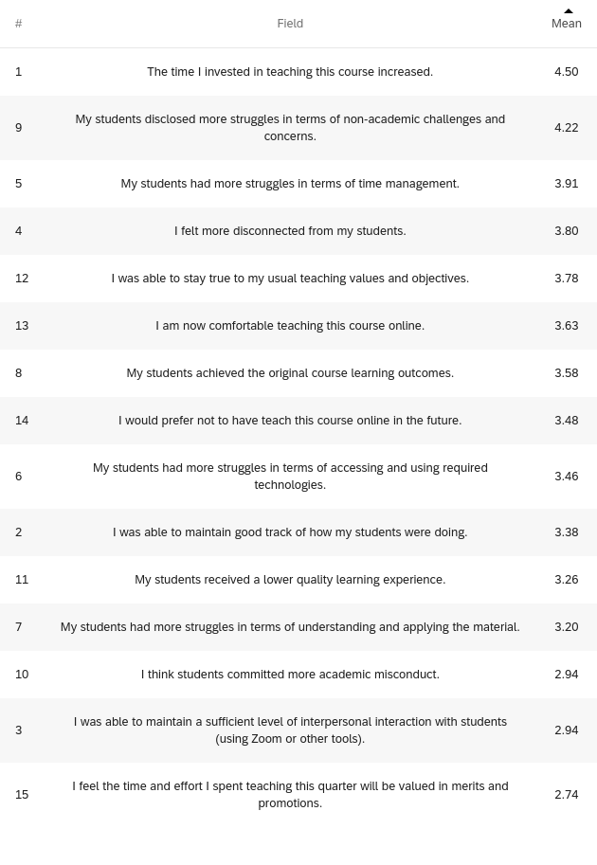
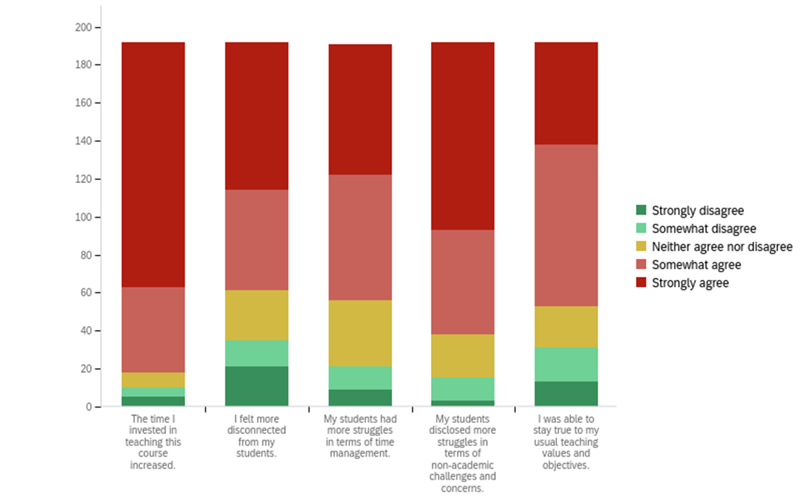
Please indicate your level of agreement with the following statements about the transition of your course(s) to remote instruction during the spring 2020 semester.

Slide 17
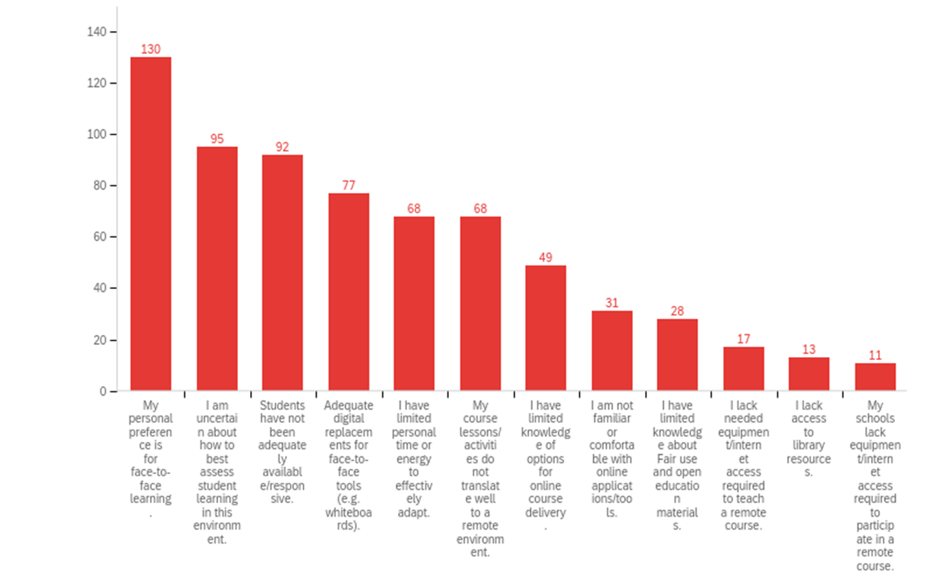
Which of the following have been challenging for you in adapting course design and/or assignments to remote learning? Select all that apply.

Slide 18
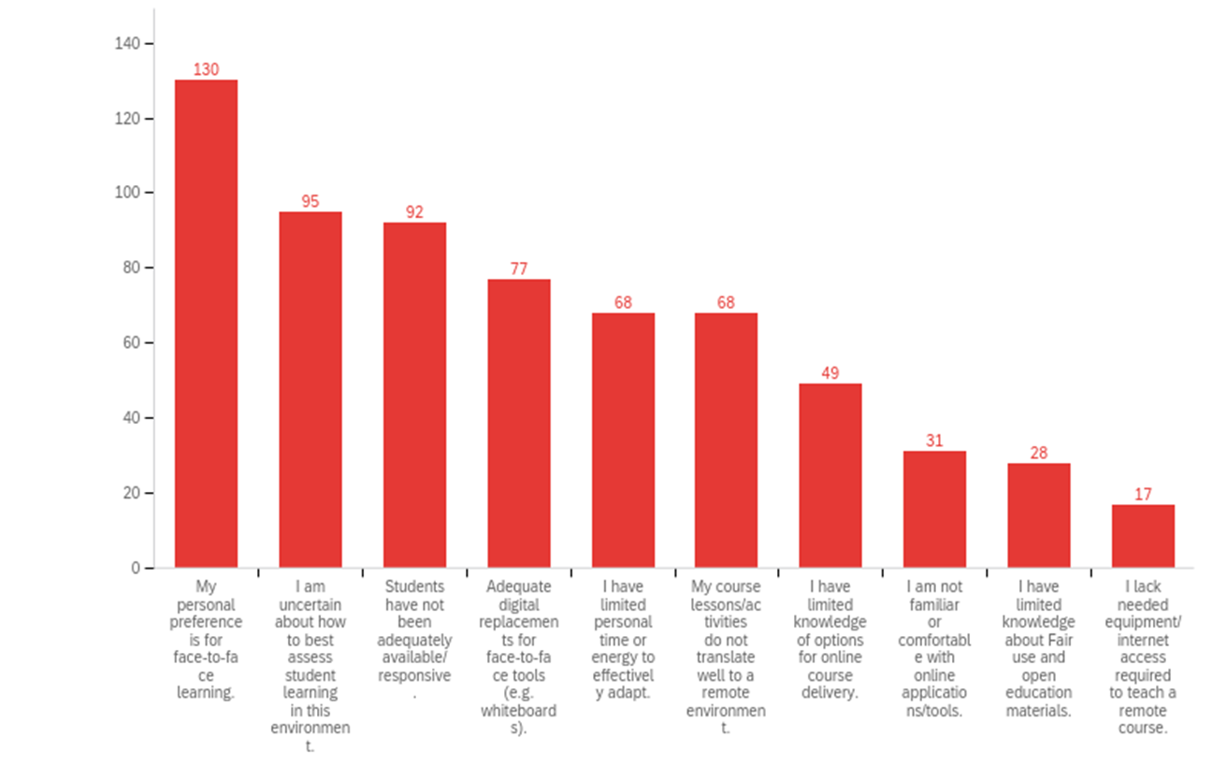
Which of the following have been challenging for you in adapting course design and/or assignments to remote learning? Select all that apply.
Notes:
Same as 17, with only top 10 shown for cleaner format

Slide 19
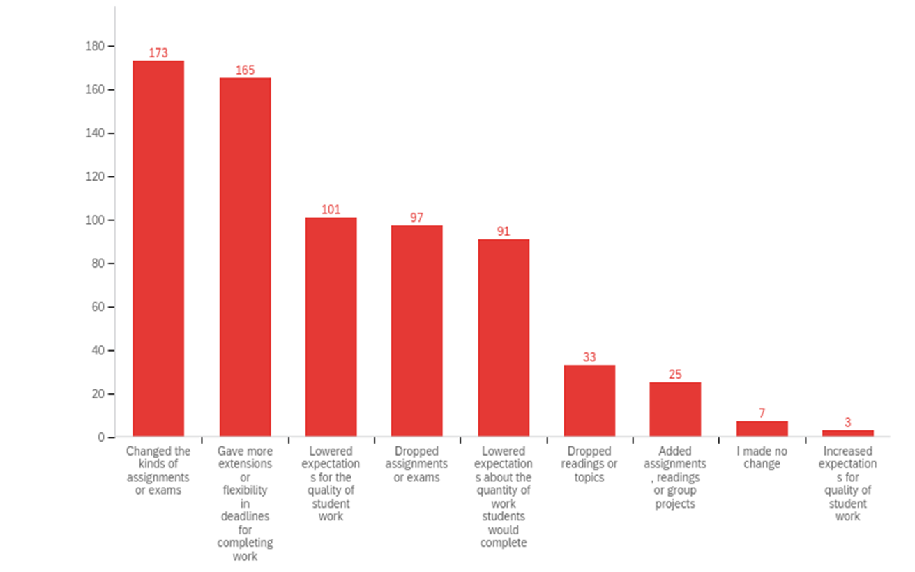
What changes did you make because of the shift to remote learning? Select all that apply.

Slide 20
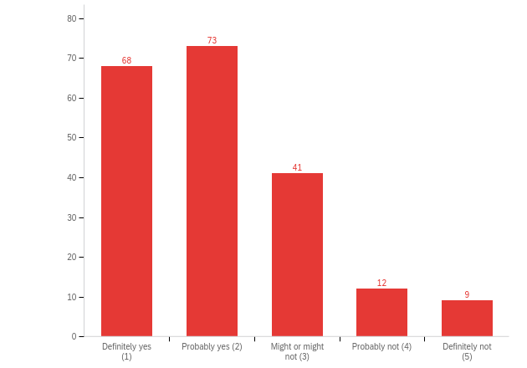
Did students receive the original course learning outcomes of your course given the changes made to accommodate remote instruction?

Slide 21
If you believe the course learning outcomes were changed, what would have helped to achieve the original course learning outcomes with a remote format?
Lab/fieldwork online
Student technology access
Synchronous attendance
Unsure

Slide 22
The effects of the COVID-19 pandemic have been different for different groups of people. What issues of equity and inclusion have you become more aware of with the shift to remote teaching? How did/will this impact your teaching?
Class disparities
Black lives matter
Home or life challenges
Bring Empathy

Slide 23
What type of resources can XCITE offer that will help with remote teaching for the summer or fall term?
More workshops
TA Training and support
Facilitate collaboration
Technology improvements

Slide 24
Student Experience

Slide 25
UCUES COVID19 Dashboard - VPDUEs
File created on: 7/27/2020 12:34:28 PM

Slide 26
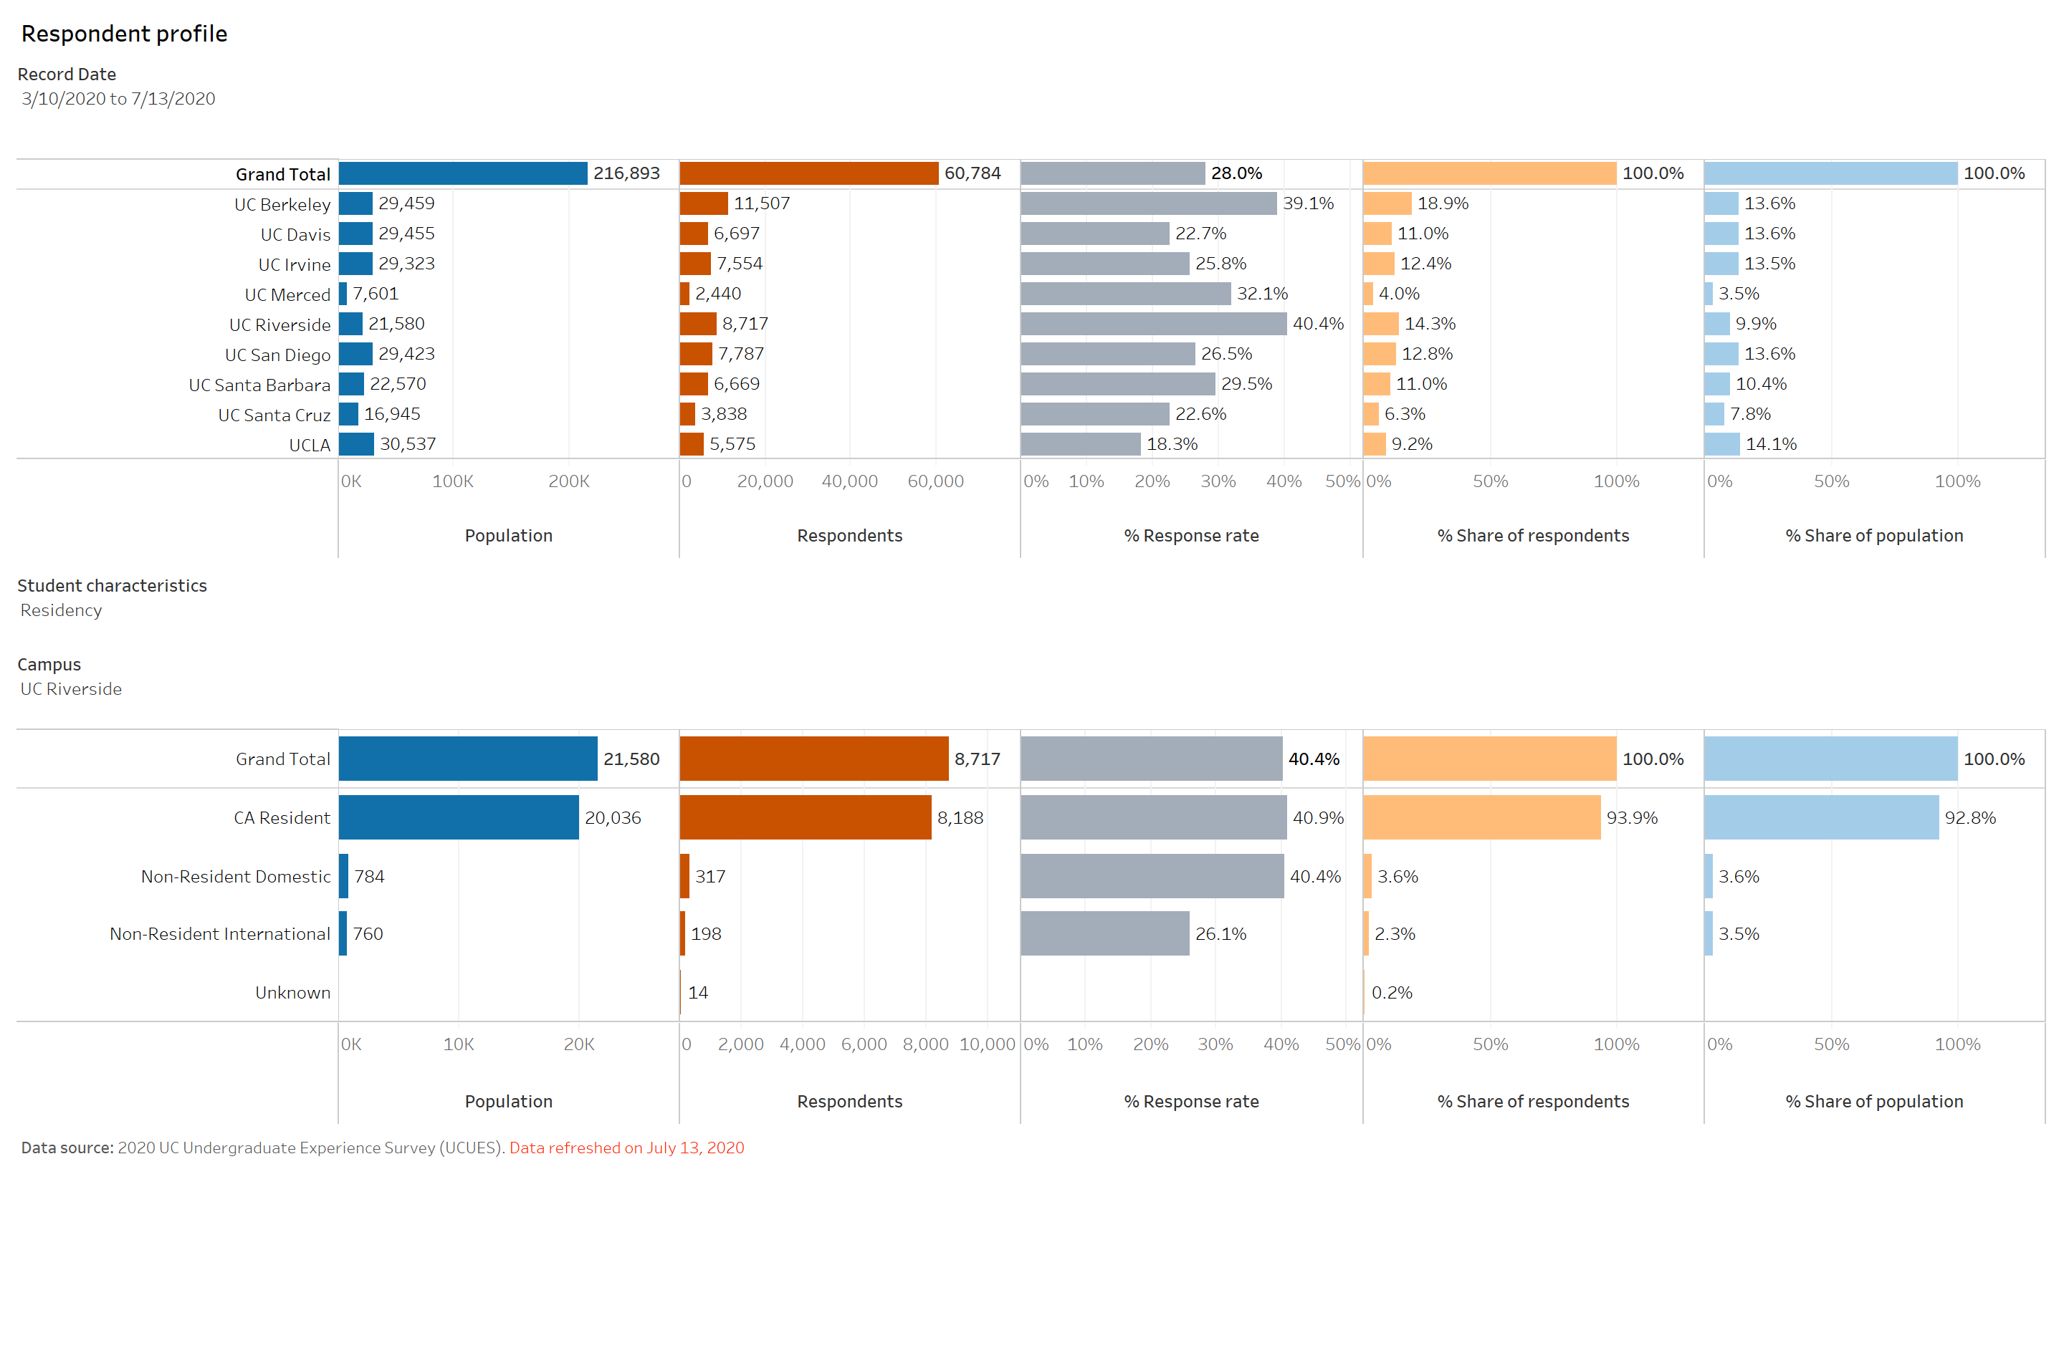

Slide 27
UCUES Student Characteristics
Residency
Ethnicity
Gender
Age Group
First Generation
Pell
Discipline
Student Level
Application Type
Family Care Responsibility

Slide 28
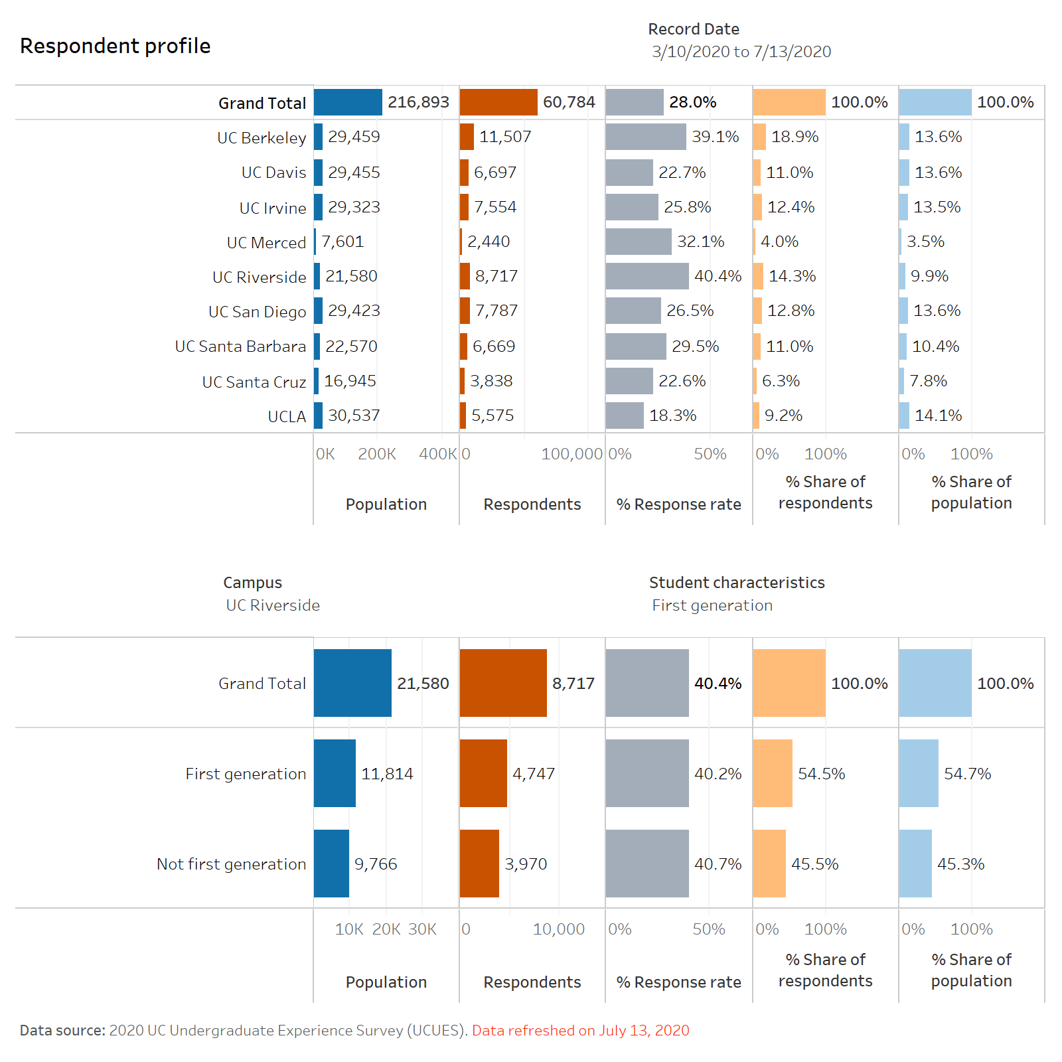

Slide 29
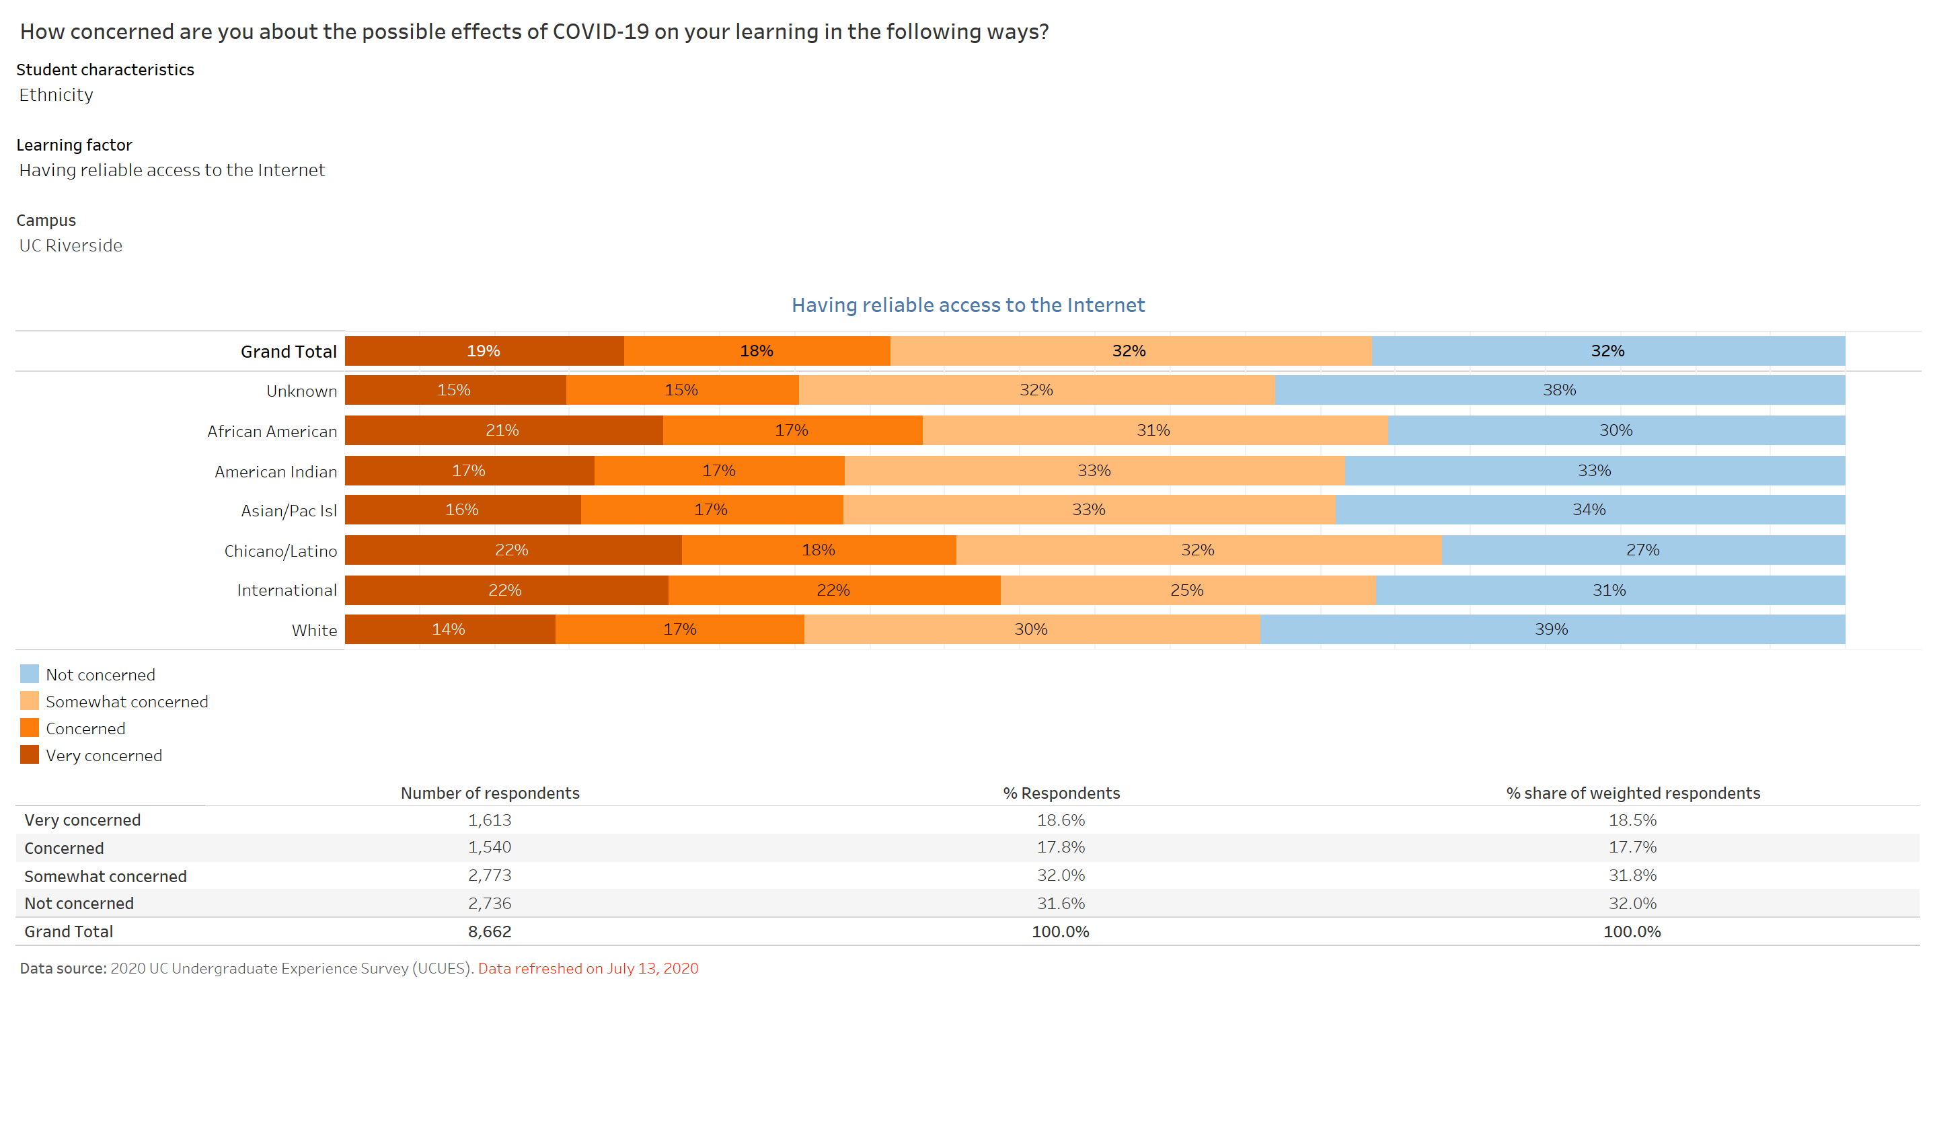

Slide 31
Differences in effects on learning
Age 51 to 60
Accessing learning support services (tutoring) (+26 percentage points)
Reliable access (+10)
Doing well on tests (+11)
Interacting with faculty outside of class (+11)
Pell
Accessing library (+5)
Study spaces (+6)
1st Gen
Study spaces (+5)
Family care responsibilities
(+5 or more on every category)

Slide 32
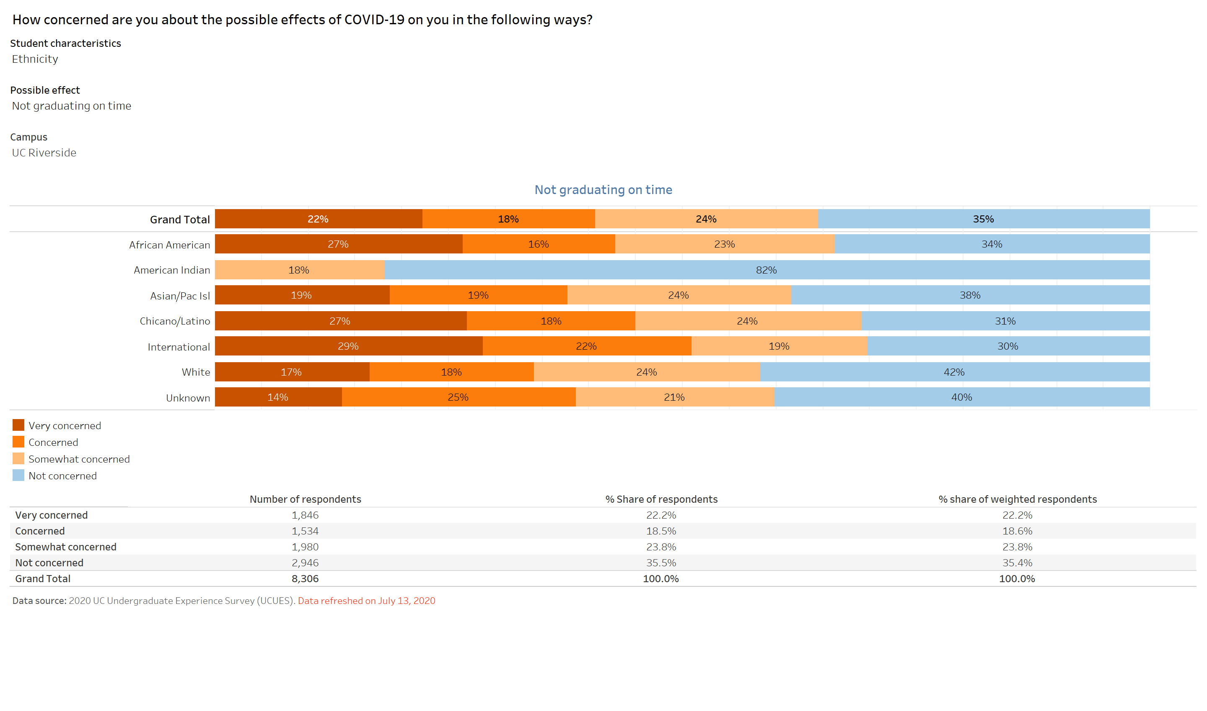

Slide 34
Differences based on COVID
Family care provider and Pell (+5 points or higher on each item)
1st Gen (+5)
Paying bills
Meeting basic needs

Slide 35
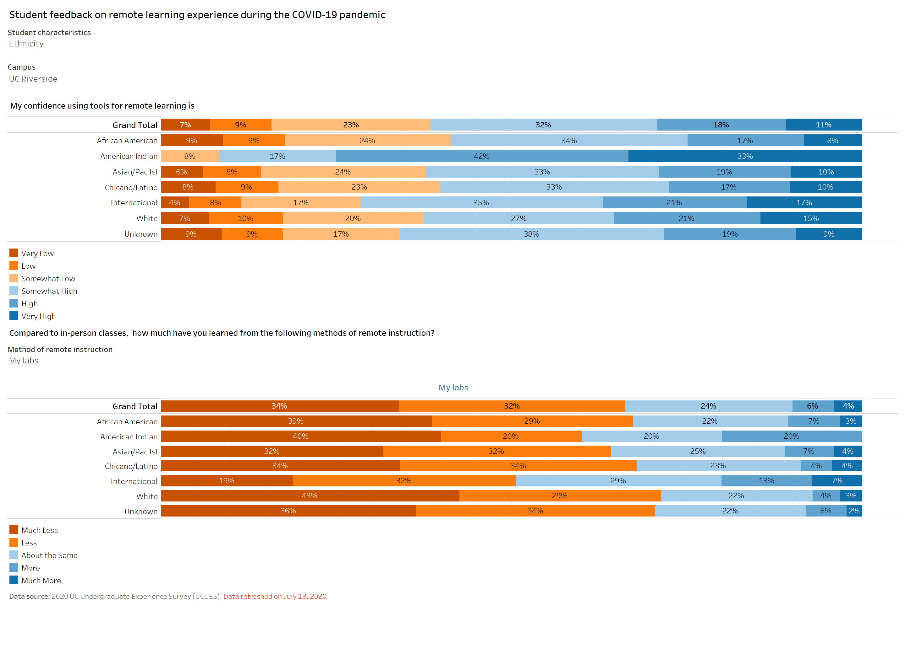

Slide 36
Confidence in remote
Differences by:
Ethnicity (American Indian +22, International +6)
Age – 29% (very high/high)
11% very high
51 to 60 (+33)
Surprisingly 21 to 25 lowest in very high category (-2 points)

Slide 37
Compared to in-person classes, how much have you learned…
Recorded remote – 51%
By ethnicity (+6 African American)
Live remote- 52%
By ethnicity (+7 American Indian)
My labs – 66%
By ethnicity (+6 American Indian, +9 White)
Performance/studio classes – 64%
By ethnicity (American Indian +19)
* Percentage are totals of much less/less categories.

Slide 38
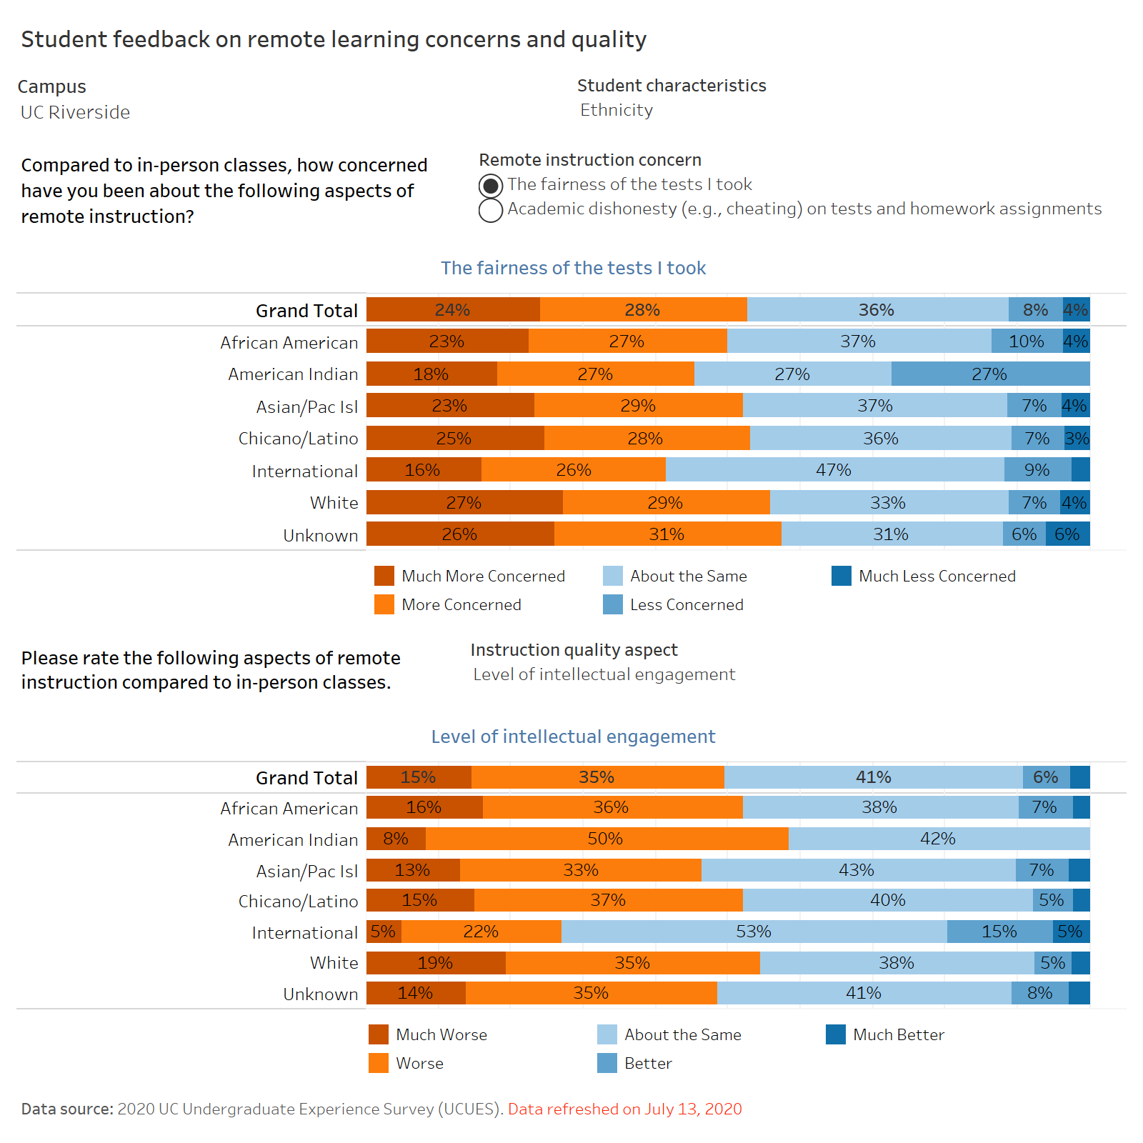

Slide 40
Remote Instruction Quality
Fairness of tests
More students concerned (52%)
36% of students felt tests were about the same
Age Group (+33 point difference in much worse)
Academic Dishonesty
45% of students thought academic dishonesty was about the same
40% thought it was much worse or worse
American Indian (+28 difference in much worse)
By discipline, (+6 Eng, +8 Life Sciences, +5 Physical Sciences- much worse)
* Percentage are totals of much worse/worse categories.

Slide 41
Please rate the aspects of remote compared to in-person instruction
Quality of interaction with faculty – 58%
Amount of interaction with faculty- 58%
Age group 51 to 64 (+24 in much worse)
Quality of interaction with TAs – 47%
American Indian (+18), 51 to 60 (much worse +45 only- then same)
Amount of interaction with TAs – 49%
Quality of interactions with other students – 69%
* Percentages are totals of much worse/worse categories

Slide 42
Please rate the aspects of remote compared to in-person instruction
Amount of interaction with other students – 72%
Quality of feedback in courses – 39%
Timeliness on course – 32%
Communication about course expectations- 31%
Level of intellectual engagement – 50%
Feelings of loneliness- 68%
* Percentages are totals of much worse/worse categories

Slide 43
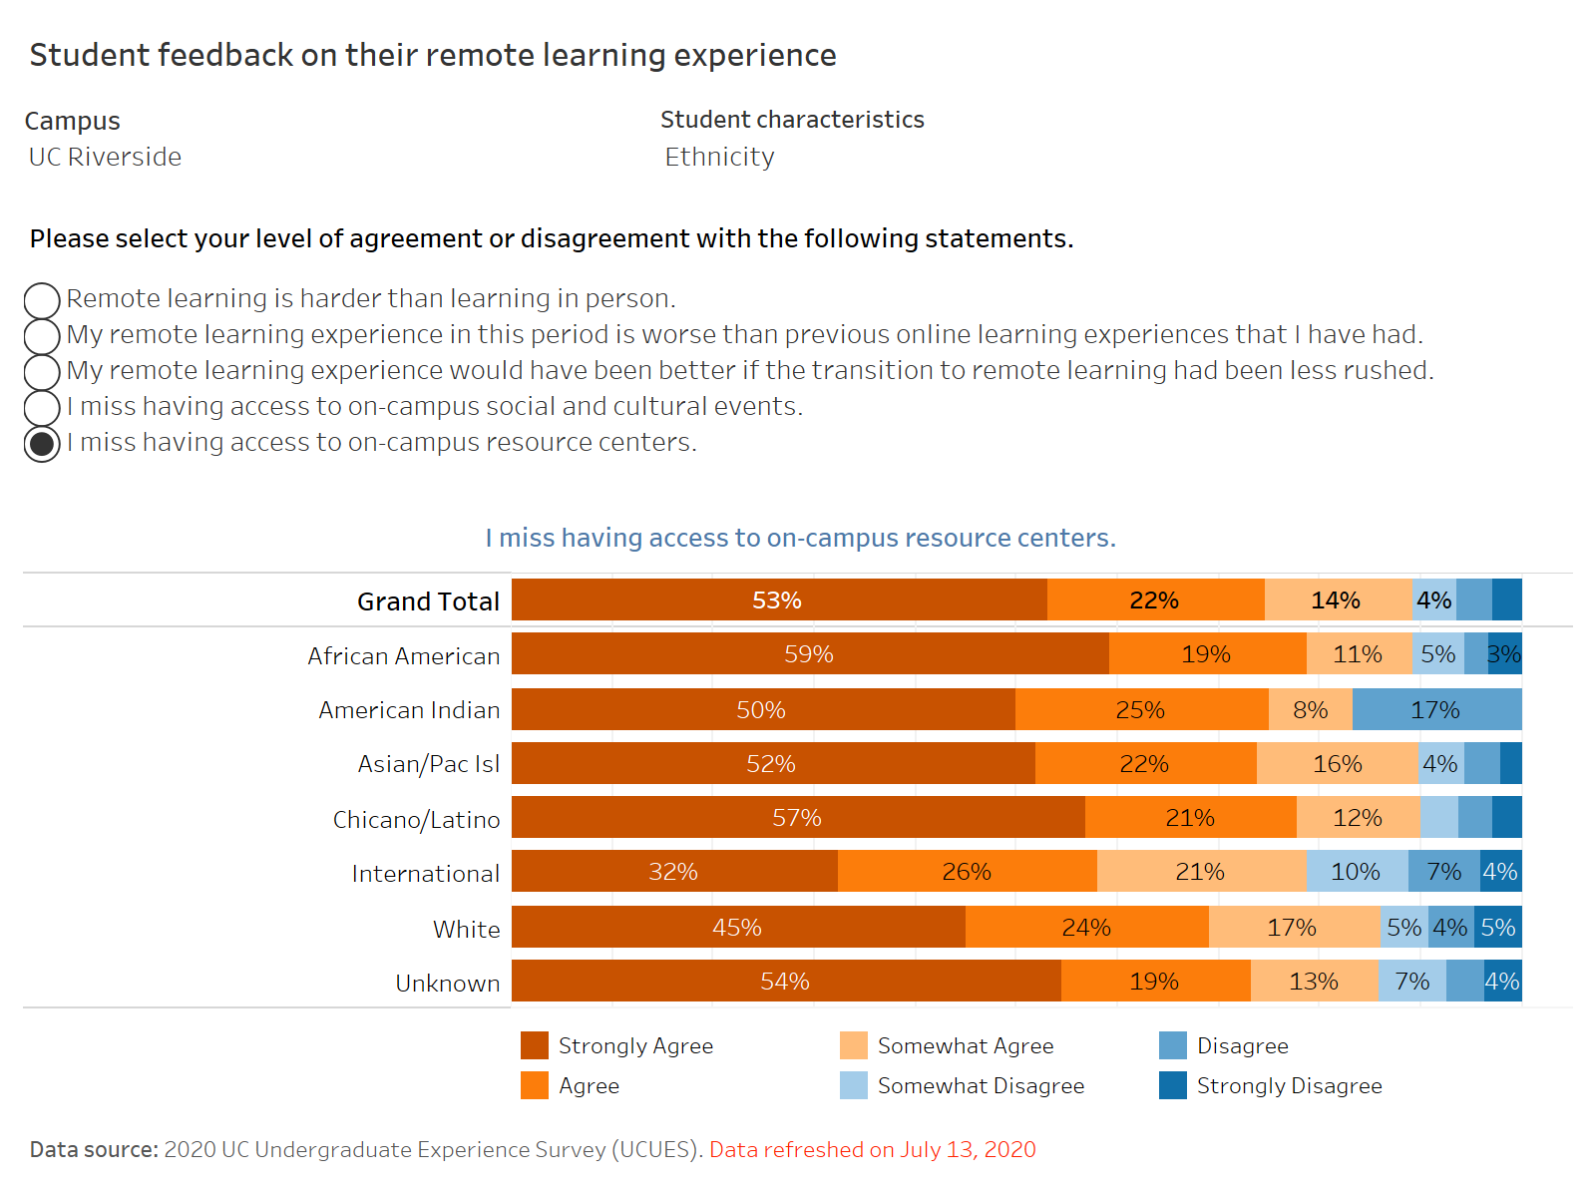

Slide 44
Student feedback on remote learning
Majority of students thought remote learning was harder than in person learning (66%)
International students (-14-point difference)
Family responsibility (+6 difference)
47% of students thought spring term’s remote was worse than previous online experiences
44% of students thought their remote learning experience would have been better if spring term wasn’t rushed

Slide 45
Student feedback on remote
Students strongly agreed or agreed (42%) they missed access to on campus social on campus resources and cultural events
American Indian (-20 point difference); African-American (+8 difference)
Students miss access to on campus resources (75%)
International students (-19 percentage point difference)

